Slide 1
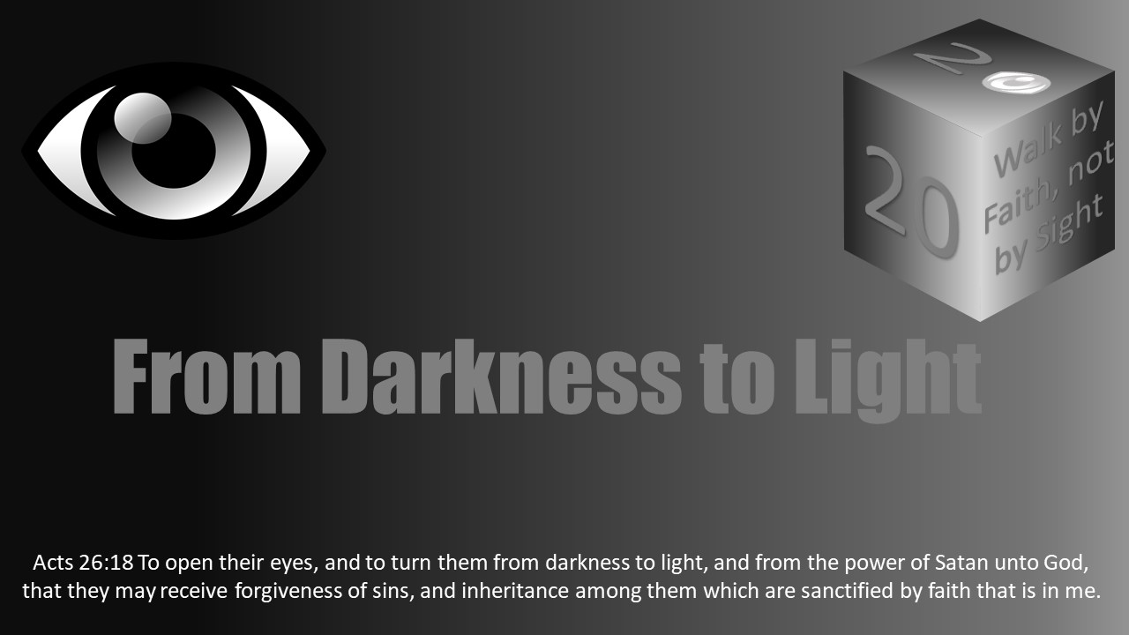


Slide 2
Darkness Lesson 19 Casting Off the Works of Darkness and Putting on the Armor of Light (Romans 13:11-14)

Slide 3
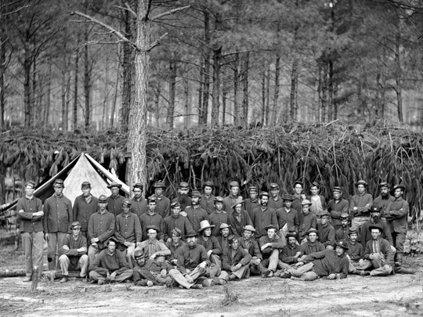
Introduction
In the final major battle of the U.S. Civil War, General Ulysses S. Grant met General Robert E. Lee at the battle of Petersburg, VA, June 1864 – April 1865.
Though recorded as a single battle, it lasted for ten months and involved a siege of Petersburg.
Five railroad lines converged at Petersburg, which, in turn, supplied the Confederate capital, Richmond, VA.
Grant understood that if he took Petersburg, he would cut off the provisions to Richmond and the war would end.
However, the stout defenses around Petersburg meant that in order to take it, Grant must first cut off the provisions to Petersburg and General Lee’s army.

Slide 4
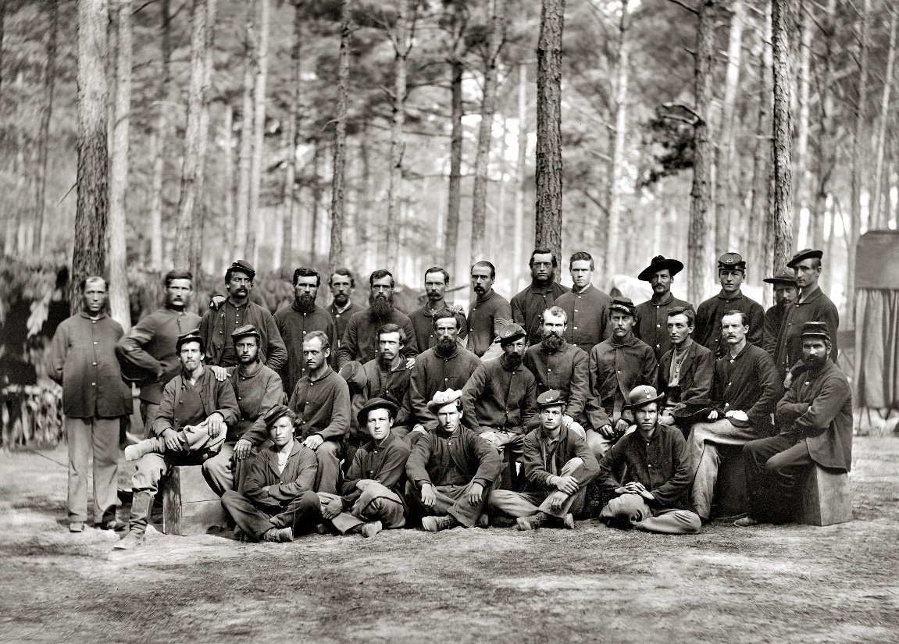
Introduction
An amazing fact of this battle is tactically, General Lee won almost every day of actual combat.
He lost fewer troops and inflicted greater casualties upon the Union forces. In some cases, 2 to 1.
However, neither Grant nor Lee would concede the battle or surrender their positions.
In this manner, the battle continued for the better part of a year.
But General Lee was nearly surrounded, and most of his supply chains were cut off. While Lee lost fewer troops in each skirmish, he was unable to replace any of them.
Meanwhile, General Grant sent a renewed force to each encounter. The Union had provisions.

Slide 5
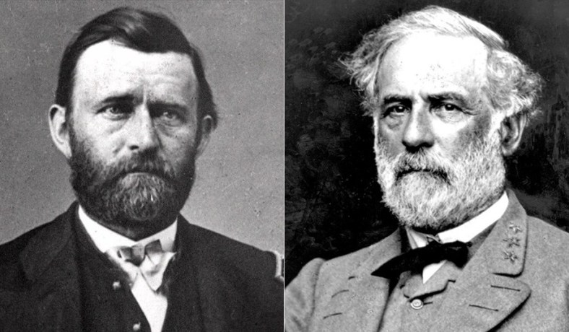
Introduction
After Petersburg surrendered, a mere two weeks passed before both Generals met at Appomattox Court House, VA where General Lee surrendered the war.
The military lesson is sobering. A war is not always won by momentary tactics or valor, but with the ability to continue, persevere, make provisions, resupply and go another round. The side who is supplied will be victorious. Who has the proper provisions? The side who has provisions will be victorious.
In warfare, the difference between victory and defeat can come down to provisions.
If one army can cut off the other army’s line of supply, communication, and/or reinforcement, then victory is only a matter of time.

Slide 6
Christian’s Warfare
Christians are called to urgent action.
Today Christians choose to equip themselves and make provisions.
Shall they take up weapons of light or provide for the works of darkness?
The side that is supplied will be victorious in their lives.
The Holy Spirit and Paul will not have Christians failing in their spiritual service and warfare because of a lack of provision.
A quick reading of Romans 12-13 provides ample actions and attitudes befitting God’s people capped off by these final exhortations to cast off works of darkness and put on the armor of light.

Slide 7

Christian’s Warfare
Put on Jesus in your life. Make provision for the right side – the Light – and cut off supplies for the enemy.
“Light” wins over “Lust” because “Light” is well supplied.
Yet the spiritual defeats, the sins Christians may practice, are because they make provisions for the lust of the flesh.
They fail to cast off the provisions for the lusts and therefore fail to cut off the works of darkness themselves.
Do not make provision for the “Lust” but supply the “Light”.
There are three steps to casting off the works of darkness and putting on the armor of light:
wake up,
suit up,
throw down.

Slide 8
Christian’s Warfare
We are at war, and the victory will go to the side with the greatest provision.
When one considers Casting Off the Works of Darkness and Putting On the Armor of Light, the Holy Spirit directs our attention to the importance of “provision” in spiritual combat.
“And do this, knowing the time, that now it is high time to awake out of sleep; for now our salvation is nearer than when we first believed. The night is far spent, the day is at hand. Therefore let us cast off the works of darkness, and let us put on the armor of light. Let us walk properly, as in the day, not in revelry and drunkenness, not in lewdness and lust, not in strife and envy. But put on the Lord Jesus Christ, and make no provision for the flesh, to fulfill its lusts” (Rom 13:11-14, NKJV).

Slide 9

Wake Up – Know the Time
For any Christian who did not understand the time or what day they were living in, the Roman letter made it clear. It is the hour to arise. Actually, it is past time to wake up. It is time to get dressed and go to war. It is time for battle.
“And do this, knowing the time, that now it is high time to awake out of sleep; for now our salvation is nearer than when we first believed. The night is far spent, the day is at hand. Therefore let us cast off the works of darkness, and let us put on the armor of light”(Rom 13:11-12, NKJV).

Slide 10
Wake Up – Know the Time
The word of God is always true. “Thy word is truth,” John 17:17.
So the apostle’s mention of “knowing the time,” “salvation,” and “the day is at hand” here should not be understood as a misguided overstatement regarding an imminent return of Jesus Christ. Some readers (and several commentators) have jumped to an eschatological lens when reading these phrases.
F.F. Bruce, writing the installment on Romans for The Tyndale New Testament Commentaries, explained: “…‘when these things begin to take place,’ Jesus had said, ‘look up and raise your heads, because your redemption is drawing near’ (Lk. 21:28). And Paul echoes his Master: ‘salvation is nearer to us now than when we first believed.’ The events of AD 64 and 66 – the beginning of imperial persecution of Christians and the outbreak of the Jewish revolt, which was to end with the collapse of the Second Jewish Commonwealth – were already casting their shadows before. That these events would not be the immediate precursor of the Second Advent and the final salvation of all believers was something which Paul could not have foreseen; if knowledge of that day and (hour was withheld even from the Son of man, it was denied a fortiori to his servant.”
F.F. Bruce, The Letter of Paul to the Romans an Introduction and Commentary- Revised Edition (Grand Rapids, MI: William B. Eerdmans Publishing, 1985 reprint 2002), 227-228

Slide 11
Wake Up – Know the Time
This line of interpretation casts doubt on Paul and the inspiration of his writing.
How could Paul be predicting the imminent Second Coming of Christ in Romans 13 without being completely wrong on the matter?
Bruce suggests Paul was mistaken, but it was not his fault.
He spoke out of turn, swayed by the headlines of political unrest in Jerusalem.
Yet, if Paul was wrong about Jesus’ return, what other errors might we find in his letters?
Today’s skeptics love to latch on to such interpretations of Scripture to malign Paul (and Jesus) as failed apocalyptic prophets.
The skeptic says, “Paul said the world would end in the first century. Jesus did not come back then, and it has been two thousand years and counting. That’s why I do not believe in the Bible. They got it wrong.”

Slide 12
Wake Up – Know the Time
Romans 13:11-12 demands no such interpretation.
Now certainly the weight of New Testament teaching is that Jesus will return and judge the world in righteousness (cf. John 5:26-29; Acts 17:30-31; 2 Cor 5:10).
Even in other places of the book of Romans, “day” is used declaring Christ’s return and judgment upon the wicked (Rom 2:5, 16).
But the judgment in Romans 2 is not said to be imminent.
Furthermore, Paul is not returning to that judgment message in Romans 13:11-12.
He is not declaring Jesus’ imminent return before the second century. What is he saying?

Slide 13
Wake Up – Know the Time
We read, “for now our salvation is nearer than when we first believed.”
Paul is laying down an axiomatic truth.
Every day in Christ is a day nearer salvation. Paul is verbally shaking Christians to understand it, remember it, and act in light of it. Know the time.
In other words, Paul is not saying, “Remember, Jesus could be here tomorrow.” Rather, Paul is saying, “Remember, you committed to living for Jesus today.”

Slide 14

Wake Up – Know the Time
Paul is rousing them to alertness.
Soldiers have a morning muster.
What happens to the soldier who is undressed and asleep in the barracks when it is time for him to be at formation?
How will a Drill Sergeant rouse him?
Here is the Holy Spirit’s reveille.
Wake up and go to arms.

Slide 15
Wake Up – Know the Time
Throughout Romans 13:11-12, Paul writes in common spiritual metaphors.
Notice “day” and “light” which symbolizes truth, justice, holiness, purity, clarity, and God.
He contrasts this with “night” and “darkness” which symbolizes deception, blindness, wickedness, shamefulness, and evil.

Slide 16
Wake Up – Know the Time
Wake vs. Sleep (Rom 13:11) It is “high time” (NKJV), “already the hour” (NASB), to wake up. Too much time has been wasted in slumber.
Near vs. Far (Rom 13:11) Again, the axiom is laid down which undergirds the paragraph: salvation is nearer than when we first believed. Today is not farther from salvation, so wake up.
Day vs. Night (Rom 13:12) This is day in contrast with night. Night is over. Christians cannot persist in the activities of night. Oversleeping when we are to be at attention is the least of the nighttime evils of which Paul writes in this context.
Light vs. Darkness (Rom 13:12) Nighttime allows for the clothing and activities of night, i.e., works of darkness. However, daytime requires the clothing and activities suitable for the day. Put on the armor of light.

Slide 17
Wake Up – Know the Time
By making these contrasts Paul, in effect, draws lines.
He draws sides.
Wake up and know the time.
Wake up and see what side you are truly on.
Who are you fighting for in spiritual battle?
Be mentally awake.

Slide 18
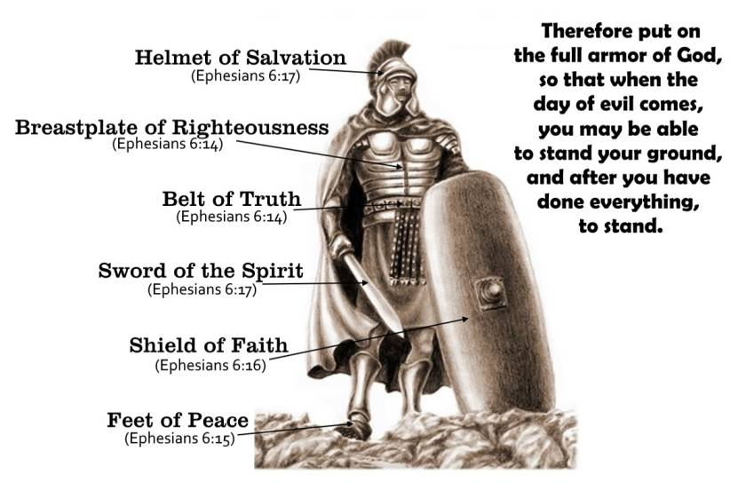
Wake Up – Know the Time
“The night is far spent, the day is at hand. Therefore let us cast off the works of darkness, and let us put on the armor of light,” (Rom 13:12, NKJV).
There are sides, and Christians choose one through their attire and activities.
Roman readers had chosen their side when they became Christians (Rom 6:3-4). Now they must act like it. Now they must manage the decision and remain on their side.

Slide 19
Wake Up – Know the Time
Additionally, warfare language like “armor” always introduces the idea of opposing sides.
We understand this in any other conflict.
You have to pick a side and stick with that side and dress for your side.
Do you recall the importance of uniforms in the U.S. Civil War?
If an actual Union soldier was captured dressed as a Confederate, or vice versa, he was tried as a traitor or a spy, and then he was hanged.
Thus, understand Christian, this is the time, the day, the moment to serve Christ and war for Christ. All that was night is past. All the debaucheries of night and evils of a sinful life before the gospel are over.

Slide 20
Wake Up – Know the Time
So, what does the Christian soldier look like? How is he recognized? What is the uniform?
A Red Coat was significant in the American Revolutionary War.
A Green Beret was meaningful in the Vietnam Conflict.
How is a Christian identified?
Those Christians who look like the world because they indulge and practice the lust of the flesh do not know the time. They must think it is night. But it is not night!
You would be completely out of place wearing pajamas during the day. Just as wearing a Confederate uniform means you do not belong on the Union army side of the battle line. It is the wrong uniform for that side.
Christian, are you wearing the uniform of Light or the uniform of Lust?

Slide 21
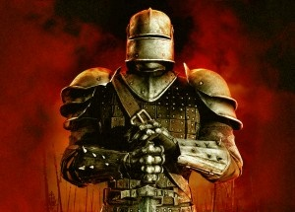
Wake Up – Know the Time
Being enlisted in the side of Christ, the side of Light, Christians must put on the armor of Light (Rom 13:12).
Interestingly, the Greek word HOPLON is rendered “armor” in most English translations.
However, HOPLON means weapons, instruments, tools, or “arms,” as in armament. It is actually the same word used in Romans 6:13 rendered “instruments.”
“And do not present your members as instruments of unrighteousness to sin, but present yourselves to God as being alive from the dead, and your members as instruments of righteousness to God,” (Rom 6:13, NKJV).
A Christian’s body and life should be tools and weapons of righteousness to God. A
very similar idea is communicated in Romans 6:13 and Romans 13:12.
Put on weapons of light so you can truly be useful tools for God.

Slide 22
Wake Up – Know the Time
God issues the proper equipment. The task is warfare. Consider some of the arms, the spiritual equipment, and suit God gives Christians to fight the good fight for Light.
Christians have a Leader, King Jesus, who vanquishes every enemy – even death (1 Cor 15:54-57; Rev 1:18; 19:11-16). Follow Him! He leads the charge with His perfect example (1 Pet 2:21). He leads His people to victory over temptation and sin (Heb 2:17-18; 4:15-16). He leads Christians into everlasting life (Heb 12:1-2; 1 Pet 1:3-9).
Christians have excellent Communication: prayer (1 Thess 5:17-18). Messages always get through. They cannot be intercepted or lost. God hears His people and answers them with what they need in His time (Matt 6:5-8).
Christians follow an inspired Battle Plan: the Bible, the scriptures. The Holy Spirit has revealed every word, and it is sufficient (2 Pet 1:20-21; 2 Tim 3:16-17). This guidebook is never wrong. It renews minds (Rom 12:2).

Slide 23
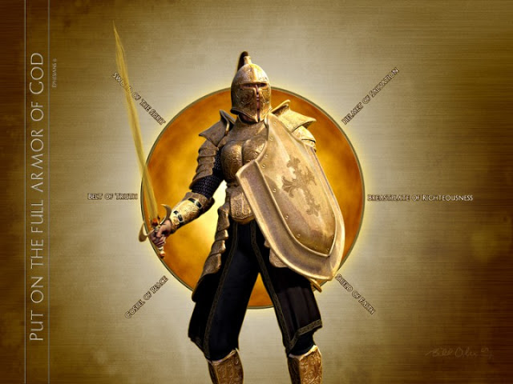
Wake Up – Know the Time
Christians have the whole Armor of God with a belt of truth, a breastplate of righteousness, feet shod with the gospel, the shield of faith, a helmet of salvation, and the sword of the spirit – the word of God (Eph 6:10-17).
Christians have Fellow Soldiers, that is, the church (Rom 12:4-5).
God’s soldiers are in this together! Brethren in the local church have to be there for one another.
Fellow soldiers bear each other’s burdens (Gal 6:2),
strengthen the weak (1 Thess 5:14),
protect one another (Acts 20:28-31),
encourage one another (1 Thess 5:11).
The church shares the victories and the heartbreaks (Rom 12:15).
They pray for each other and sacrifice for each other because they love each other (1 John 3:16; 4:19-21).
Together, Christians march forth in the armor of light to go to war. The task is war – spiritual war.
Paul gives a particular tactic to battle lust for the sake of light: Cut off the enemy’s provision.

Slide 24

Throw Down – Cut Off The Provision
Cast off (or throw down) works of darkness and make no provision for them at all.
“Let us walk properly, as in the day, not in revelry and drunkenness, not in lewdness and lust, not in strife and envy. But put on the Lord Jesus Christ, and make no provision for the flesh, to fulfill its lusts,” (Rom 13:13-14, NKJV).

Slide 25
Throw Down – Cut Off The Provision
Cut off provision for the flesh.
Do not supply lusts of the flesh.
Remember the Battle of Petersburg? General Lee lacked provisions. He had fewer soldiers and could not replace any of them. General Grant lost more soldiers at any given engagement but replaced all of them.
Many battles have been won and strongholds were overtaken because the supplies were cut off.
Notice the parallelism:
“Cast off the works of darkness” (Rom 13:12)
“make no provision for the flesh to fulfill its lusts” (Rom 13:14).
“Works of darkness” are paralleled to lusts of the flesh.
“Cast off” is paralleled with “make no provision.”

Slide 26
Throw Down – Cut Off The Provision
The Greek PRONOIA is rendered “provision” in most English Bibles.
It means forethought, supply, providential care.
Proper thought and supplies are required to accomplish certain works, aren’t they?
So Paul warns Christians not to supply the flesh.
He is not prescribing asceticism.
However, indulging the lust of the flesh supplies works of darkness in one’s life.
Remember, the side who is supplied ultimately wins.

Slide 27
Throw Down – Cut Off The Provision
Paul gives three couplets as examples of works of darkness. This is not an exhaustive list of all sin. Yet these crimes against the soul are often perpetrated at night.
“Let us walk properly, as in the day, not in revelry and drunkenness, not in lewdness and lust, not in strife and envy” (Rom 13:13, NKJV).
Notice the provision aspect within these couplets. How can Christians continue practicing such works of darkness? Observe what supplies them – what provides for them – so evil work can be done. This is especially obvious if you inverse the order of each couplet.
Drunkenness provides for Revelries
Lust provides for Lewdness
Envy provides for strife

Slide 28
Throw Down – Cut Off The Provision
Cut OFF
Drunkness Provides for Revleries
Cut OFF
Lust provides for Lewdness
Cut OFF
Envy provides for strife
Put on the
Armor of Light

Slide 29

Drunkenness provides for Revelries
One would be hard pressed to morally defend the debauchery of riotousness and excesses of revelries.
Not only were they raucous parties but they were often associated with idolatry of licentious pagan gods. Thayer’s Greek Lexicon explains KOMOS (revelries),
A nocturnal and riotous procession of half-drunken and frolicsome fellows who after supper parade through the streets with torches and music in honor of Bacchus or some other deity, and sing and play before the houses of their male and female friends; hence, used generally, of feasts and drinking parties that are protracted till late at night and indulge in revelry.
Joseph Henry Thayer, A Greek-English Lexicon of the New Testament (New York: American Book Company, 1886, 1889) 367

Slide 30

Drunkenness provides for Revelries
A soldier of light has no business in that scene.
How embarrassing and damaging to a reputation to be caught at such a party when the police show up and arrest people for disorderly conduct, public intoxication, and disturbing the peace.
A Christian forfeits godly influence in the lives of his fellow carousers.
As long as he parties along, he compromises the integrity of his own faith and discredits the church.

Slide 31

Drunkenness provides for Revelries
Of course, intoxication is a significant component of revelry.
One must provide for, that is, supply drunkenness to accomplish revelry.
So how does one defeat revelry?
Cut off the supply of drunkenness.
If one does not start down the path of drinking alcohol and other substance abuse, they do not arrive at carousing and wild, out-of-control parties.

Slide 32
Drunkenness provides for Revelries
Let’s not be content to simply cut off the provision for drunkenness and revelries though. Let’s be sure to provide ammunition for the other side – the weapons of light!
“Do not be overcome by evil, but overcome evil with good” (Rom 12:21, NKJV).
What is some good that can be brought to bear on these works of darkness?

Slide 33
Throw Down – Cut Off The Provision
Christian, wake up!
If you find association with a particular group of people invariably leads to weekends of drinking and drug-infused parties, it is high time to cease being around those people.
Choose weekend activities with other people.
Develop friendships with Christians who do not pursue drinking and drinking parties, but instead those who seek God’s love, righteousness, and holiness.

Slide 34
Throw Down – Cut Off The Provision
Some people’s lives are tragic.
If you see them on a Monday and ask, “How was your weekend?” Too many times they reply, “Well, we were drinking and…”
“There was this party and you should’ve been there…”
It is simply tragic how they celebrate and aggrandize their own self-destruction.
What is truly happening is they are losing the ability to enjoy life and relationships without the crutch of addictions.
It’s heartbreaking to know someone’s humanity is being destroyed weekend by weekend, and they are only too delighted to sacrifice it for a few hours of high with worldly peers.

Slide 35
Throw Down – Cut Off The Provision
It is high time to take up a new evening hobby or weekend entertainment.
It is high time to surround yourself with people of different interests and shared spiritual values.
Just the influence of people with different social norms and expectations can go a long way in cutting off the supply to such works of darkness and filling our lives with the light of God.
But if enough time has been spent with alcohol and other substance abuse, one will find it difficult to cast if off.
The flesh develops an insatiable hunger for such poisons.
Some habits and routines are comfortable now.
Feeling grief, stress, or perhaps even joy without the filter of dissipation seems unnatural.
Personal relationships have been defined through all of this lifestyle of behavior.
Perhaps the word to capture the various struggles is addiction.

Slide 36
Throw Down – Cut Off The Provision
Not apart from prayer and church fellowship but in addition, obtain focused help through an alcohol or substance abuse program.
Enlist brothers and sisters in Christ for support and accountability.
Throw down drunkenness and revelry and all that provides for them.

Slide 37

Lust provides for Sexual Promiscuity
While the NKJV renders the Greek KOITE as “Lewdness” other translations help the English reader better understand what the Holy Spirit is saying, such as the ESV’s “sexual immorality” or the NASB’s “sexual promiscuity.” KOITE is the Greek root for the English word, Coitus.
Illicit sexual relationships, driven by lust, are sinful works of darkness.
As the supply of lust continues, it eventually works sexual immorality.
What should the battle plan be to defeat such promiscuity?
Cut off the supply of lust.

Slide 38
Lust provides for Sexual Promiscuity
Doubtless, lust and promiscuity walk hand in hand with drunkenness and revelries.
Orgiastic parties are fueled by inhibition-lowering intoxicants. But not always.
Many teetotalers fall prey to lust and sexual sin.
Again, let us not simply cut off the provision of lust and immorality, but let’s replace it with ammunition for the light.
Let’s provide for the light. Let’s overcome evil with good (Rom 12:21).

Slide 39
Lust provides for Sexual Promiscuity
It is generally acknowledged today that consuming lust-inducing pornography has the potential to be as addictive as consuming alcohol or pills.
In like manner, the flesh develops an insatiable hunger for explicit imagery.
Habits, routines, and coping mechanisms become entwined with carnal passions.
Personal relationships have been colored, and the heart deadened to natural sympathies, through the continual objectification of people – even if the lust is indulged in secrecy.
A terrible cycle of guilt, shame, and relapse become difficult to break.

Slide 40
Lust provides for Sexual Promiscuity
Thus, not apart from prayer and church fellowship but in addition to, enrolling in a sexual addiction program may be the most strategic step to take in casting off lust.
Confession and prayer with other Christians who will walk through a difficult season with you are necessary.
Other lessons in this series stress the importance of an accountability partner.
Furthermore, resources like filtering software or content-blocking apps are helpful.

Slide 41
Lust provides for Sexual Promiscuity
Of course, minds and hearts warped by exposure to pornography seek to act out the images they have feasted on and fantasized about.
Lust provides for sexual promiscuity.
But what provides the continual temptation to pornography?
Few seem to realize the regular bombardment of sensual images on television continually tempt people to seek out pornographic images beyond what the FCC allows for public broadcast.

Slide 42
Lust provides for Sexual Promiscuity
With every foolish sexual encounter and wickedness of pre-marital sex and “hook-ups”, the side of darkness and night wins.
It’s high time to wake up and grow up in Christ and seriously seek to honor, biblically love, and marry a spouse.
Understand that one aspect of marriage is for the fulfillment of sexual expression (1 Cor 7:1-9; Heb 13:4).
The sexual relationship is a beautiful and good union, as God designed it, in the context of marriage.
But being loose with your body and casual, if not nearly anonymous, with sexual partners is sin.
As a result, it brings the severest consequences emotionally, physically, and spiritually.
Such will not inherit the kingdom of God (1 Cor. 6:9-11, 18-20).
Throw down lust and sexual promiscuity and all that provides for them.

Slide 43

Envy Provides for Strife
Are their hard feelings, disputes, and strife among men?
It would not be hard to imagine that in the darkness of a group of “friends” sharing alcohol, drugs, wild parties, and sexual partners that quarrels and contentions – strife – would arise.
But without all the other, certainly a supply of envy or jealousy (NASB) accomplishes strife among men.
How could strife be tempered?
Cut off the supply of envy.

Slide 44
Envy Provides for Strife
Envy and jealousy in the heart betray a lack of gratitude for the blessings God has given His people.
Greed and covetousness are growing in the heart.
These attitudes color our perception of others.
Our interactions only become negative with them, and we perceive them as an enemy.
It is hard to love an enemy we actually envy.
Soldiers of light are peacemakers. Romans 12 teaches us actions and attitudes that cut off envy, which in turn, cut off strife.
“He who gives, with liberality” (Rom 12:8).
“Distributing to the needs of the saints, given to hospitality” (Rom 12:13.
“Bless those who persecute you, bless and do not curse” (Rom 12:14).
“Repay no one evil for evil” (Rom 12:17).

Slide 45
Envy Provides for Strife
When Christians concern themselves with giving, sharing, and aiding others, it creates an attitude of gratitude.
Thanksgiving is fostered for what we have and all the good we can do with it.
Jealousy focuses on what others have and how we wish we had it.
Envy judges people unworthy of having what they have.
How selfish and misguided Christians can be.
But when Christians repay evil with good and return blessing for cursing, they use weapons of light.
Throw down envy and strife and all that provides for them.

Slide 46
Throw Down – Cut Off The Provision
These observations about cutting off provision in spiritual warfare are not to suggest one error or sin is better than another or less than another.
There is a compounding relationship, and one thing easily leads to another and can sustain another.
Be encouraged for the good things – the armor of light – compound as well.
This realization can help us understand to use our tools and weapons to attack and control the enemy’s provision. Cut them off!
Cut off even the provisions for envy, lust, and drunkenness.
Again, Paul does not give an exhaustive list of sin, but these pairs certainly show us how we do not want to provide for any of the lusts of the flesh.
The side that is supplied wins. You choose your side.

Slide 47

Put On Jesus Christ
This paragraph of scripture ends with an exhortation to put on Christ.
“But put on the Lord Jesus Christ, and make no provision for the flesh, to fulfill its lusts” (Rom 13:14, NKJV).
As Christians put on the Lord Jesus Christ, they must act to make provisions for His side and not for the lusts of the flesh.
One puts on Christ, initially, through baptism – immersion in water (Rom. 6:3-4; Gal. 3:26-27).
In this response of faith and obedience to the gospel message, a relationship with God is changed, and one becomes a child of God and a soldier of light.

Slide 48
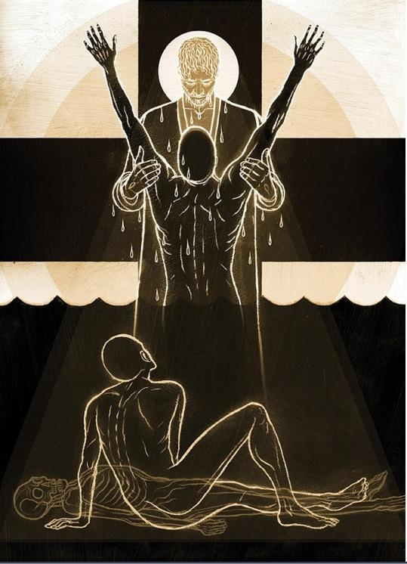
Put On Jesus Christ
As Christians grow in faith and learn His word, they continue to add to, understand better, and expertly handle all the weapons of light.
Christians put on Christ in baptism and continue to put on Christ each day as they cast off the works of darkness and put on the armor of light.
Preachers have long exhorted Christians along these same lines.
In the early second century, they wrote encouraging saints to arm themselves in Christ and rally to spiritual combat.
Resisting lust has always been a battle.

Slide 49
Put On Jesus Christ
Ignatius wrote to Polycarp on the duties of the Christian Flock:
“Please ye Him under whom ye fight, and from whom ye receive your wages. Let none of you be found a deserter. Let your baptism endure as your arms; your faith as your helmet; your love as your spear; your patience as a complete panoply.”
Ignatius, “Epistle of Ignatius to Polycarp, VI. 2” in Alexander Roberts and James Donaldson ed. Ante-Nicene Fathers Vol. 1 (Peabody, MA: Hendrickson Publishers 1885, Reprint 2012), 95
The Shepherd of Hermas, Christians must fight evil desires:
“You must refrain from evil desires, that by refraining ye may live to God. But as many as are mastered by them, and do not resist them, will perish at the last, for these desires are fatal. Put you on, then, the desire of righteousness; and arming yourself with the fear of the Lord, resist them. For the fear of the Lord dwells in good desire. But if evil desire sees you armed with the fear of God, and resisting it, it will flee far from you, and it will no longer appear to you, for it fears your armor.”
“The Shepherd of Hermas Book II, Commandment 12, Chapter 2” in Alexander Roberts and James Donaldson ed. Ante-Nicene Fathers Vol. 2 (Peabody, MA: Hendrickson Publishers 1885, Reprint 2012), 28-29

Slide 50
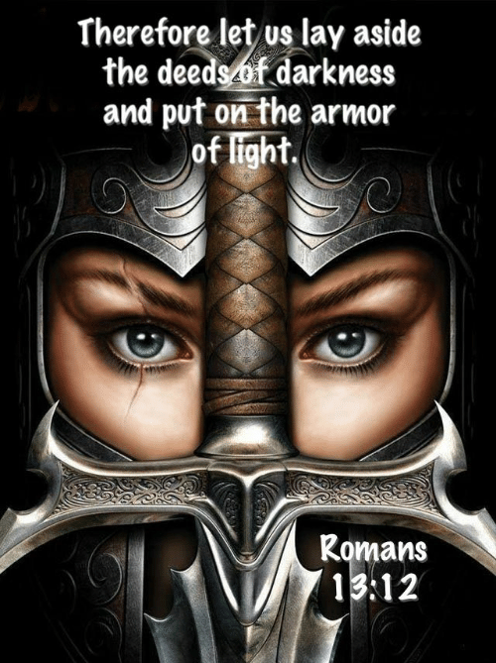
Put On Jesus Christ
Through the ages, Christians have dressed themselves through baptism, faith, love, and patience.
They have also clothed themselves with the fear of the Lord. It has not changed because scripture (such as Romans 13:11-14) has not changed.
Cast off the works of darkness and put on the armor of light. It’s your choice, today.
Further Reading: Brent Moody, “’Put on the Armor of Light’: Imitating Christ” in David McClister, ed., Light Shall Shine Out of Darkness (Temple Terrace, FL: Florida College Press, 2015) 179-196

